Slide 1
Developer’s Fatigue

Slide 2
Motivation
Mental fatigue is caused due to exhaustion and tiredness, triggered by long and demanding tasks [1].
Studies [2] have shown possible relations between mental fatigue and specific programming tasks such as a program construction, modeling and debugging.
Mental fatigue has also a negative effect on memory and cognitive functionalities and these functionalities play a vital role in a program construction and modeling [2].
This contribution intends to define some measurements for measuring the mental fatigue and analyzing its effect on developers’ performance.

Slide 3
Introduction
Fatigue: exhaustion, tiredness, lethargy, languidness, languor, lassitude, and listlessness.
Health functioning and everyday life.[1]
Fatigue is one of the 13 mood states. [4]
Fatigue is a complex happening depended on various factors [5]
Leads to cognitive failures like distraction, low decision power, less reasoning capabilities, and poor attention and focus [6]
Mental fatigue is defined as a state of weariness, which diminishes motivation. [4]

Slide 4
Subjective quantification of fatigue [5]
Dull Drowsy
Feel heavy in the head
Feel tired in the whole body specially limbs
Yawn
Feel the brain hot or muddled
Become drowsy
Feel strained in the eyes
Exhausted
Become rigid and clumsy in motion
Feel unsteady while standing
Want to lie down
Mental decline of working motivation
Become apt to forget things
Lack of self-confidence
Anxious about things
Unable to straighten up in posture
Lack of patience

Slide 5
Subjective quantification of fatigue [5]
Mental decline of working motivation
Become apt to forget things
Lack of self-confidence
Anxious about things
Unable to straighten up in posture
Lack of patience
Specific feeling of incongruity in body
Have a headache
Feel stiff in the shoulders
Feel pain in the waist
Feel constrained in breathing
Feel thirsty
Have a husky voice
Dysfunction of autonomic nervous systems
Have dizziness
Have a spasm of the eyelids
Have a tremor in the limbs
Feel ill

Slide 6
Validating Motivation
Online Survey
312 participants
Participants includes: Software Engineers, Students (Former Software Engineers), Students (no experience)
Communities targeted: Quora, Reddit, CodeProject, Facebook
Initial experimental validation using an instrumentation tool (Eclipse plug-in)

Slide 7
Survey Questions
Sleep
How many hours do you sleep typically, in a day?
How long did you sleep last night?
What are the factors, you think, lead to mental fatigue in your life mostly? (Check all that apply)
Stress
Mood
Sleepiness
Physical work
Non-willingness towards work
Fatigue at Work
Do you think fatigue is a severe and frequent problem for programmers?
When you are tired at work, you are most likely to do which of the following?
Continue working until the work is completed
Switch to other tasks until you regain your concentration
Stop working and rest
Do you feel when you are tired that it influences your performance? If yes, what are some examples?
What makes to conclude that your performance is deteriorating or you need a break at the moment?
Work
How long do you code in a day?
Describe your daily work routine. Does this routine occur during the morning, afternoon, or night?
What factors might reduce your energy/concentration level as you code, throughout the day?
Age:

Slide 8
Survey responses

Slide 9
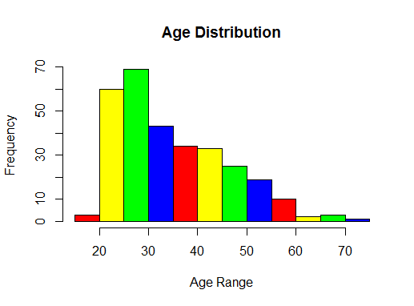
Participants Population

Slide 10
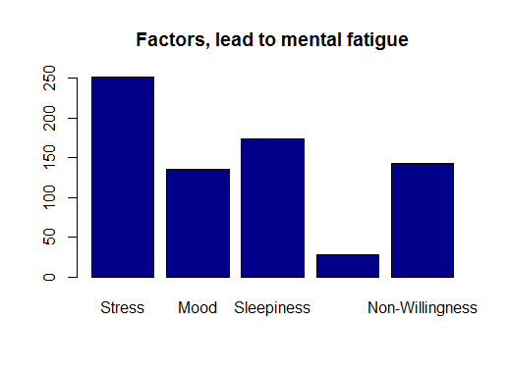
Factors lead to mental fatigue

Slide 11
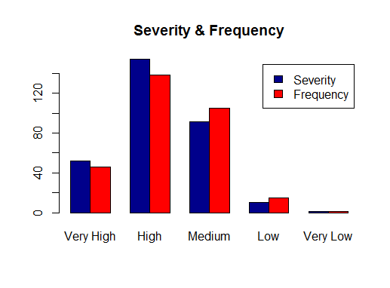
Fatigue : severe and frequent?

Slide 12
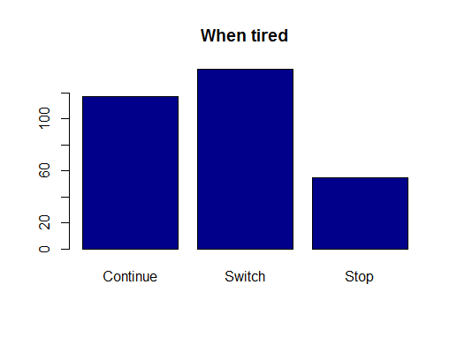
When tired ?

Slide 13
Subjective Questions (to be)

Slide 14
Instrumentation

Slide 15
DevFatigue
DevFatigue is an activity tracking plug-in for Eclipse. It is an extension of Rabbit [https://code.google.com/p/rabbit-eclipse/]. Alike Rabbit, it works in the background with Eclipse and tracks all the activities you perform. It only tracks the actions when Eclipse is active. And logs the data in XML (human readable) format at specific location.
The Rabbit features*, which it supports by default:
Commands - How often you use each commands (cut, copy, paste etc), do you know which is your favorite?
Editors and Views - Time spent using different tool within Eclipse, such as Java Editor, Outline view.
Perspectives - Time spent using different perspectives.
Sessions - Time spent using Eclipse.
Resources - Time spent working on difference resources such as files, projects.
Java Elements - Time spent working on Java elements such as classes, methods.
Launches - Launches such application runs, debug runs etc, and the relevant files will be recorded too when you step into them using the during debugging.
Task - Time spent working on tasks (tasks in Task List view) and resources.
*content taken from Rabbit Information Page

Slide 16
DevFatigue
Additional features in DevFatigue:
User Activity - The typing speed (key board usage) of the user with respect to a time period.
Focus Events - The activities related to keys and mouse usage, like Key Up, Key Down, Mouse Clicks, Mouse Velocity, etc. with specific to time period.
Project Events - Information regarding the projects like ‘imports’, and commands used with respect to time period.

Slide 17
Intention
The data collected by DevFatigue can be processed into information, required for analyzing the developer’s working pattern.
Features added in the plugin:
Key Up
Key Down
Mouse Click
Mouse Double Click
Mouse Velocity
Edit Speed
Imports
Commands

Slide 18
Intention
Following data can also be calculated from the list on the previous page:
1. Difference between key up and key down. 2. Usage of backspace 3. Mouse Velocity 4. Time between key presses 5. double clicks / difference between two
The architecture of the proposed framework is the extension of the used in some of the previous studies [7][3].

Slide 19
Analysis Model

Slide 20
References
[1] Lauren S. Aaronson, Cynthia S. Teel, Virginia Cassmeyer, Geri B. Neuberger, Leonie Pallikkathayil, Janet Pierce, Allan N. Press, Phoebe D. Williams, and Anita Wingate. Defining and Measuring Fatigue. Journal Of Nursing Scholarship, 1999; 31 :1, 45-50.
[2] Schneiderman B, and Mayer JE. Syntactic/semantic interaction in programmer behaviour: A model and experimental results. Int J Comput Inf Sci 8(3):219–238, 1979.
[3] André Pimenta, Davide Carneiro, Paulo Novais, and José Neves. Analysis of Human Performance as a Measure of Mental Fatigue. HAIS 2014, LNAI 8480, pp. 389–401, 2014.
[4] Lauren S. Aaronson, Cynthia S. Teel, Virginia Cassmeyer, Geri B. Neuberger, Leonie Pallikkathayil, Janet Pierce, Allan N. Press, Phoebe D. Williams, and Anita Wingate. Defining and Measuring Fatigue. Journal Of Nursing Scholarship, 1999; 31 :1, 45-50.
[5] Kazuo Saito. Measurement of Fatigue in Industries. Industrial Health 1999, 37, 134-142.
[6] Larson GE, Alderton DL, Neideffer M, and Underhill E. Further evidence on dimensionality and correlates of the Cognitive Failures Questionnaire. Br J Psychol 88(1):29–38, 1997.
[7] André Pimenta, Davide Carneiro, Paulo Novais, and José Neves. Monitoring Mental Fatigue through the Analysis of Keyboard and Mouse Interaction Patterns. J.-S. Pan et al. (Eds.): HAIS 2013, LNAI 8073, pp. 222–231, 2013.

